Slide 1
Design Patterns

Slide 2
Introduction to Design Patterns
Practical proven solutions for recurring software design problems.
Guide software structure and improve flexibility, reusability, and maintainability.
Not a code library; a conceptual design solution applied by developers.
Similar to tested recipes for solving common design challenges.

Slide 3
Importance and Applications of Design Patterns
Reduce repeated design effort and improve software quality.
Create reusable and maintainable object-oriented systems.
Provide common communication language among developers.
Applications: enterprise systems, web applications, frameworks, large software projects.

Slide 4
Gang of Four (GoF) Pattern Catalogue
Introduced by Erich Gamma, Richard Helm, Ralph Johnson, and John Vlissides.
Contains 23 classic object-oriented design patterns.
Patterns are grouped based on purpose: Creational, Structural, Behavioural.
Provides a common reference for solving software design problems.

Slide 5
Pattern Languages
A collection of related patterns for a specific problem domain.
Pattern selection depends on system context and design goals.
Different domains require different combinations of patterns.

Slide 6
Categories of Design Patterns
Creational Patterns: object creation and initialization.
Structural Patterns: organization and relationships among objects.
Behavioural Patterns: communication and responsibility distribution.

Slide 7
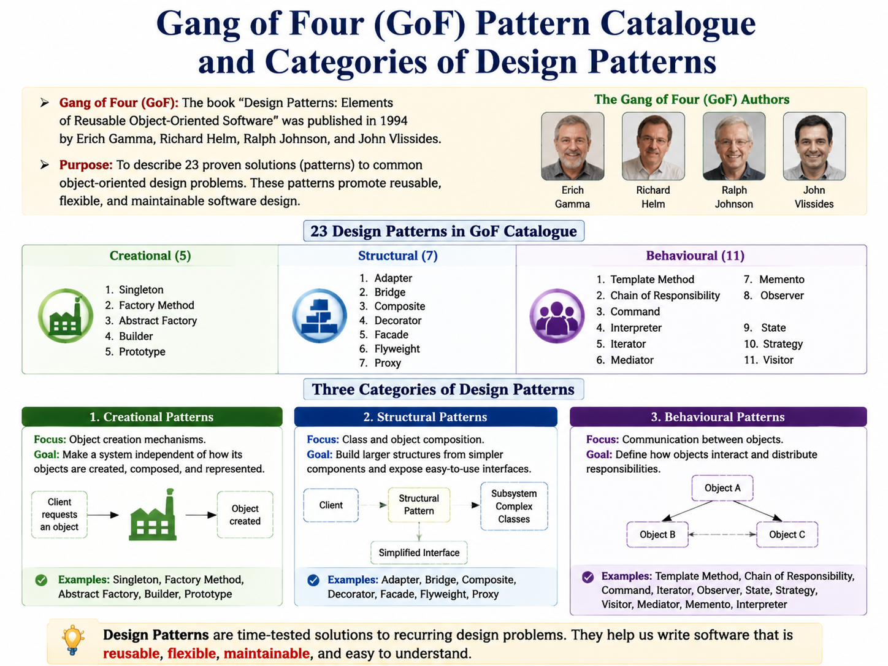
Gang of Four (GoF) Pattern Catalogue

Slide 8
Creational Patterns
Focus on flexible object creation mechanisms.
Reduce dependency on concrete object classes.
Examples: Singleton Pattern, Factory Method Pattern.

Slide 9
Singleton Pattern
Creates only one instance of a class.
Useful when a single shared object is required.
Implementation: private constructor, unique instance variable, getInstance() method.
Examples: database connection, printer queue, configuration manager.

Slide 10
Singleton Pattern
1. Create private static instance variable.
2. Hide constructor using private access modifier.
3. Create public method to provide instance access.
4. Return existing instance if already created.

Slide 11
Factory Method Pattern
Separates object creation from object usage.
Client depends on general interfaces instead of concrete classes.
Allows new object types without modifying client code.

Slide 12
Factory Method Steps
1. Create Product interface or abstract class.
2. Create concrete product classes.
3. Define factory method in creator class.
4. Subclasses decide which object to create.

Slide 13
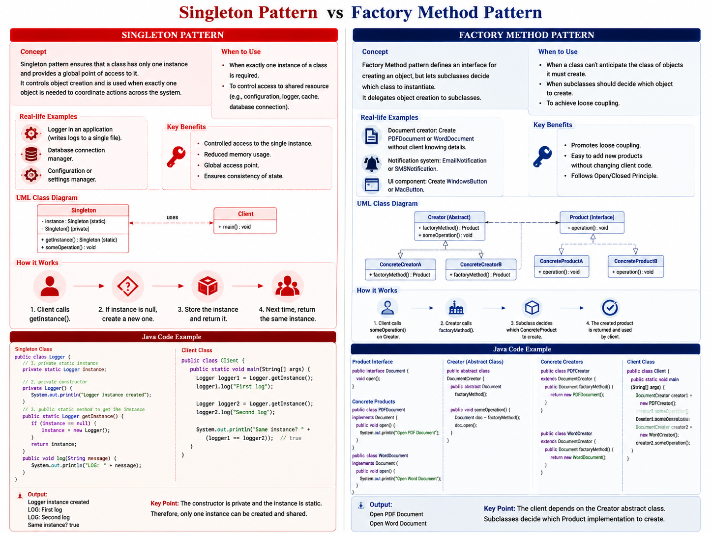
Factory Method Steps

Slide 14
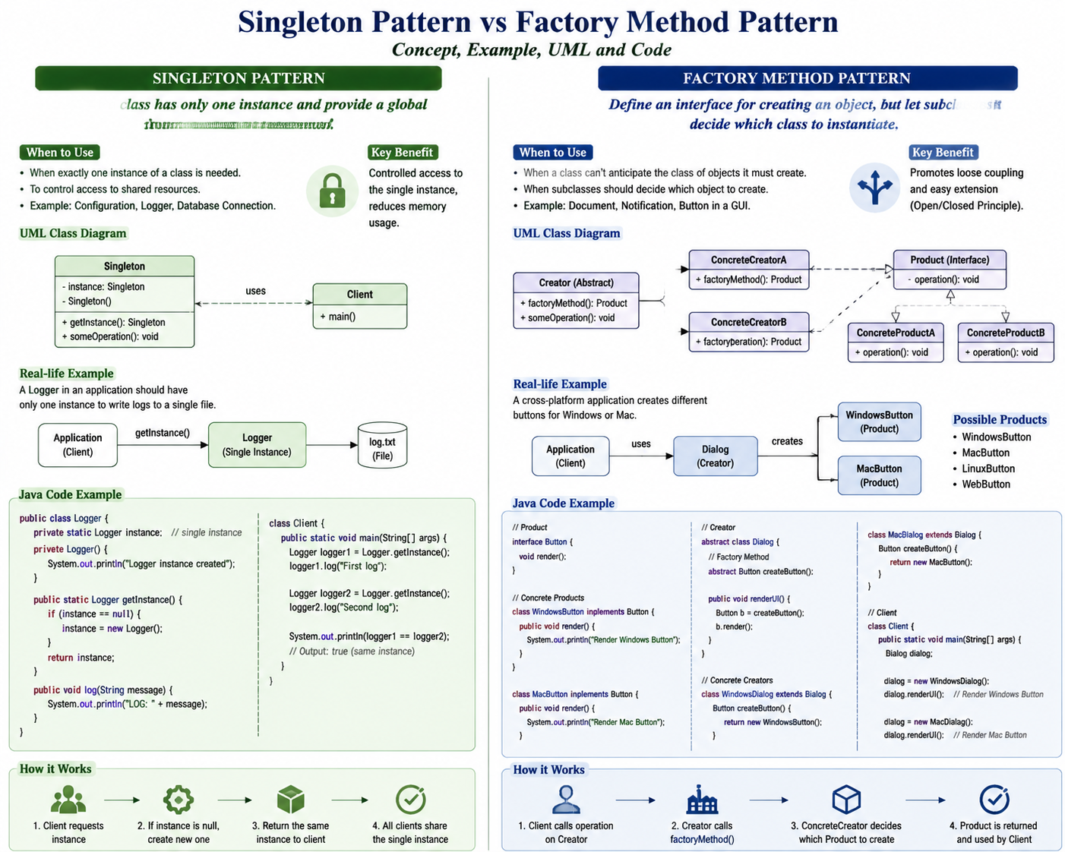
Factory Method Steps

Slide 15
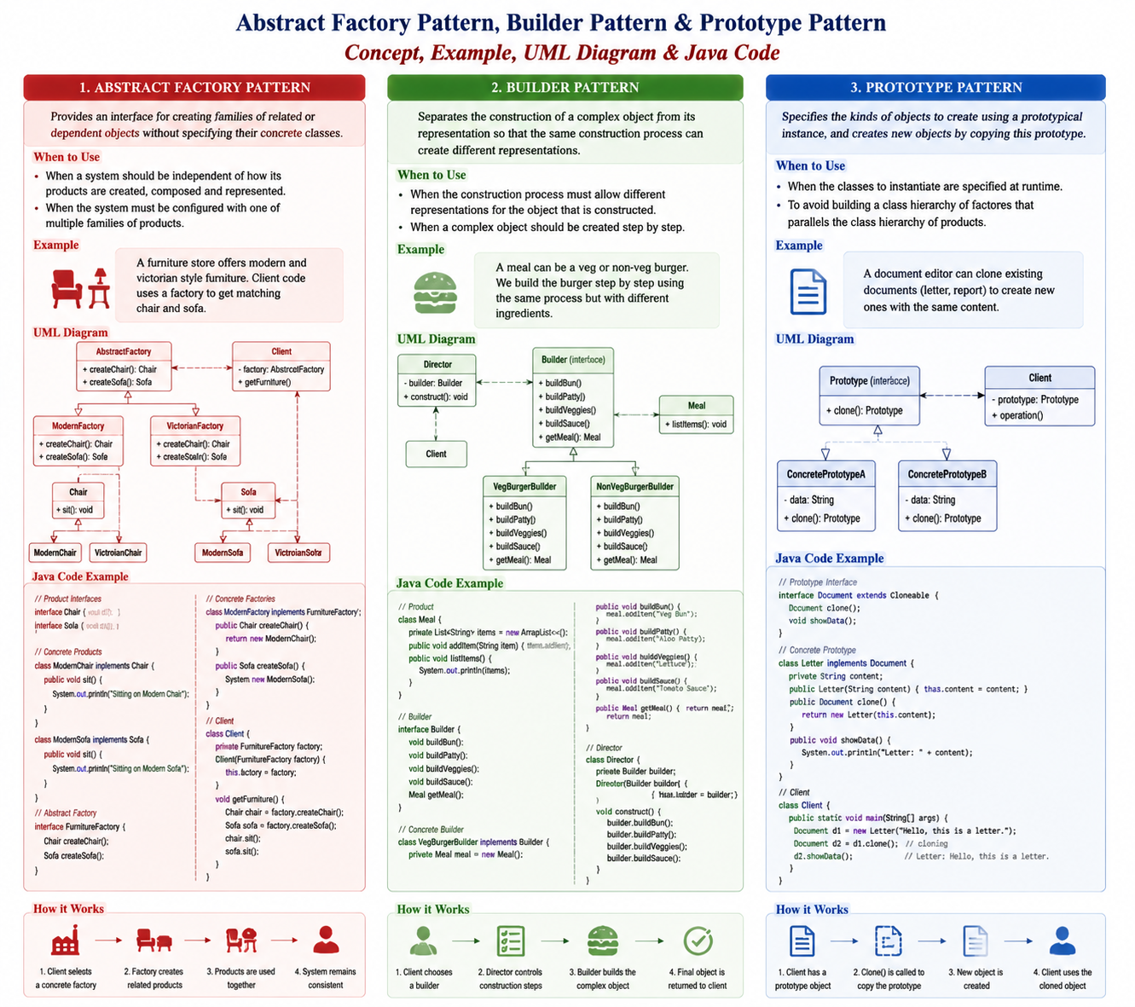
Factory Method Steps

Slide 16
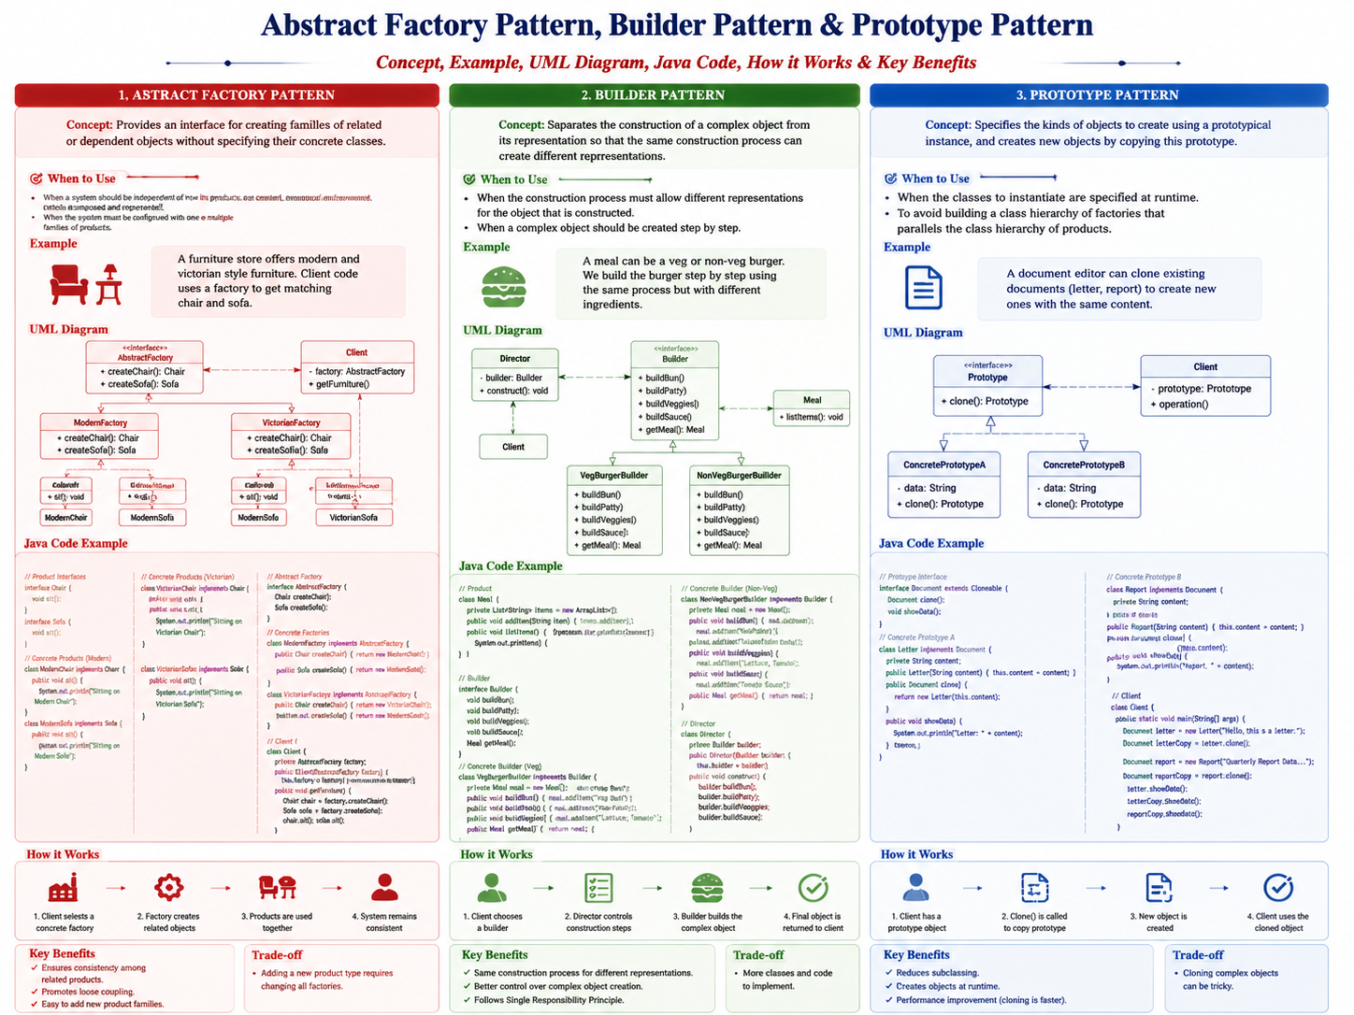
Factory Method Steps

Slide 17
Structural Patterns
Describe how objects and classes are organized and connected.
Support decomposition and flexible relationships.
Examples: Facade, Adapter, Composite, Proxy, Decorator.

Slide 18
Facade Pattern
Provides a simple interface to a complex subsystem.
Hides internal subsystem details from clients.
Reduces coupling and simplifies interaction.

Slide 19
Facade Pattern Steps
1. Design subsystem interfaces.
2. Implement subsystem classes.
3. Create facade wrapper class.
4. Client uses facade instead of multiple subsystem classes.

Slide 20
Adapter Pattern
Allows incompatible interfaces to communicate.
Works as a bridge between client and existing system.
Components: Client, Target Interface, Adapter, Adaptee.

Slide 21
Adapter Pattern Steps
1. Design target interface.
2. Implement adapter using target interface.
3. Convert client requests into adaptee format.
4. Client communicates through adapter.

Slide 22
Composite Pattern
Creates tree-like object structures.
Allows individual objects and groups to be treated uniformly.
Examples: file systems, organization structures.

Slide 23
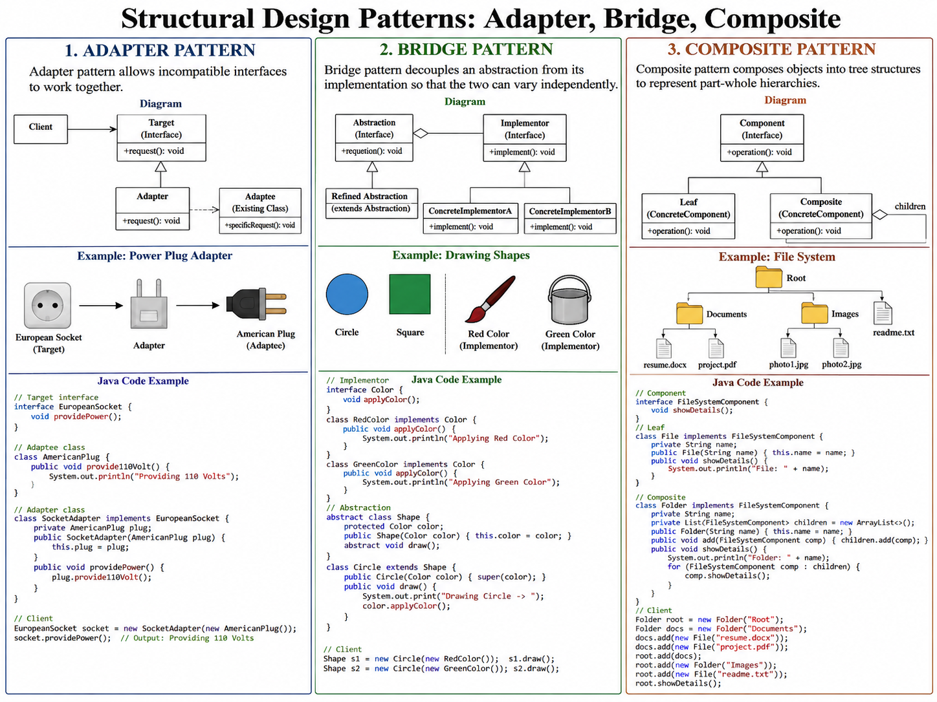
Composite Pattern
Creates tree-like object structures.
Allows individual objects and groups to be treated uniformly.
Examples: file systems, organization structures.

Slide 24
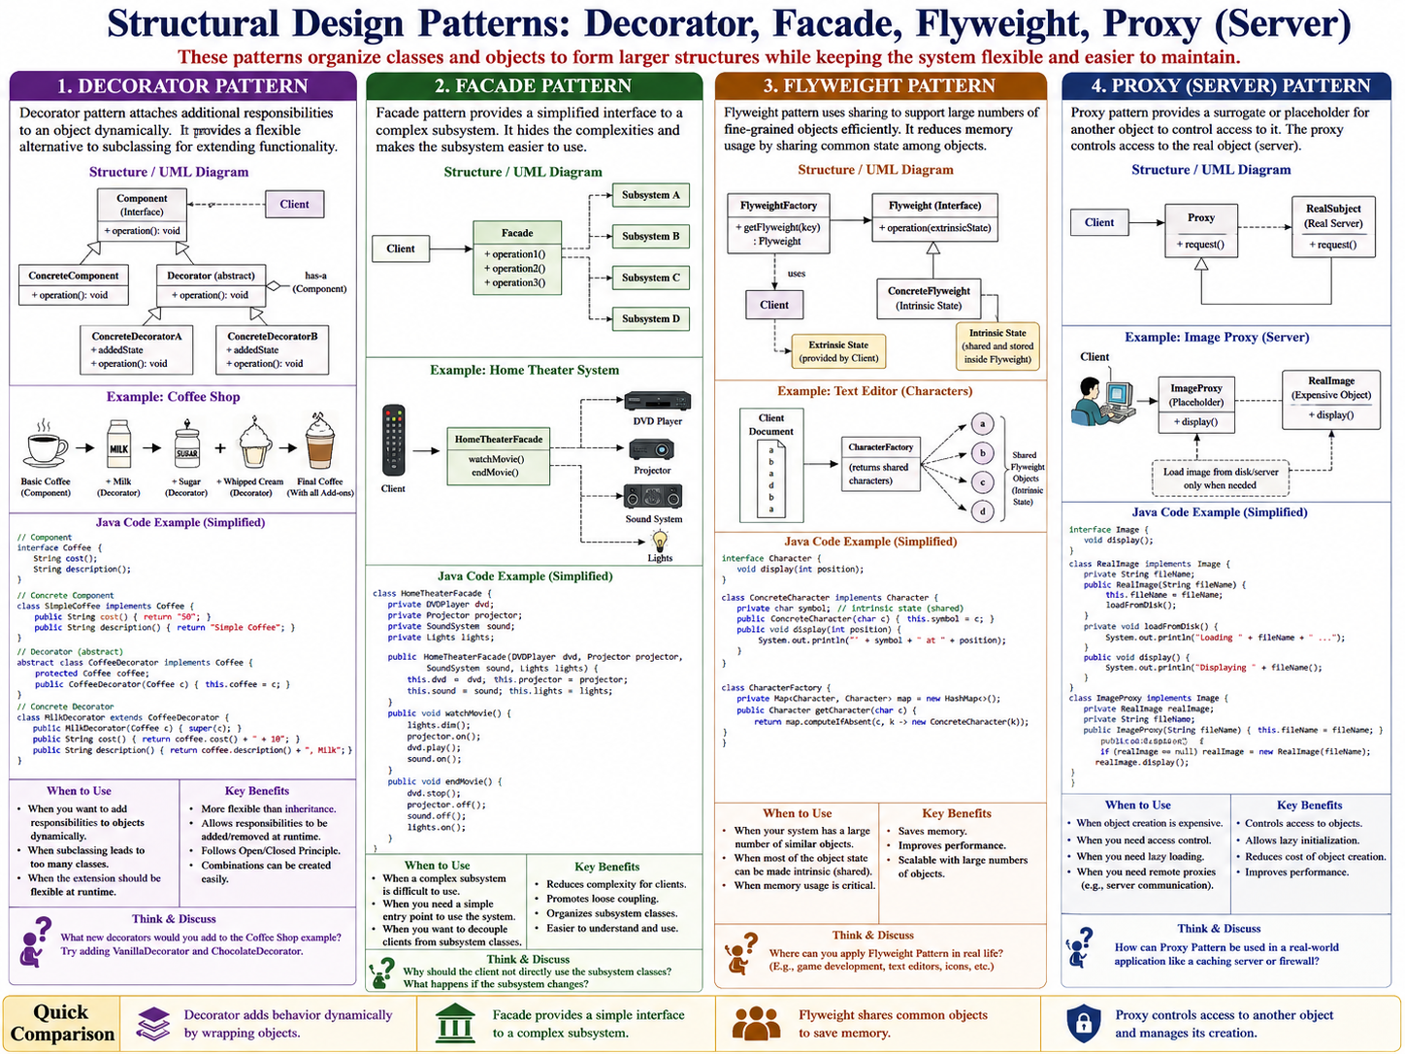

Slide 25
Proxy Pattern
Provides a substitute object controlling access to another object.
Used for security, performance optimization, and resource management.

Slide 26
Decorator Pattern
Dynamically adds responsibilities to objects at runtime.
Uses aggregation instead of creating many subclasses.
Allows flexible combinations of behaviours.

Slide 27
Decorator Pattern Steps
1. Design component interface.
2. Implement concrete component.
3. Implement abstract decorator.
4. Create concrete decorators adding behaviours.

Slide 28
Module 1 Summary
Design patterns provide reusable solutions for common design problems.
Creational patterns manage object creation.
Structural patterns organize object relationships.
Good pattern selection improves maintainability and flexibility.

Slide 29
Sample Question
Bloom's Level | Focus | Typical Question Verbs
Remember | Recall facts/concepts | Define, List, Name, Identify
Understand | Explain concepts | Explain, Describe, Summarize, Discuss
Apply | Use knowledge in a situation | Apply, Demonstrate, Implement, Use
Analyze | Break down and find relationships/problems | Analyze, Compare, Differentiate, Examine
Evaluate | Make a justified judgment | Evaluate, Critique, Justify, Assess
Create | Produce a new design/solution | Design, Develop, Create, Propose
Bloom's Level | Question
Remember | 1. List the seven structural/creational patterns covered in Module 1.
Understand | 2. Explain the main purpose of the Facade Pattern and give one practical example.
Understand | 3. Explain how the Adapter Pattern allows two incompatible interfaces to work together.
Apply | 4. A legacy payment system provides makePayment(), while a new application expects pay(). Which pattern would you apply and how would it solve the problem?
Analyze | 5. Analyze a file-system design containing File and Folder objects. Explain why the Composite Pattern may be appropriate for representing this hierarchy.
Evaluate | 6. Compare the Proxy and Facade Patterns. Evaluate which pattern would be more appropriate for controlling access to an expensive remote service and justify your answer.
Create | 7. Design a home-theater system using the Facade Pattern. Identify the subsystem classes, Facade class, and the operations exposed to the client.
Bloom's Level | Question
Remember | 1. What is a design pattern? Name the three major categories of GoF design patterns.
Understand | 2. Explain the purpose of the Gang of Four (GoF) design pattern catalog.
Understand | 3. Explain the difference between creational and structural design patterns with suitable examples.
Apply | 4. Suppose an application requires exactly one shared configuration object throughout the system. Which design pattern would you use? Explain how you would apply it.
Analyze | 5. Analyze the following situation: a program directly creates many different concrete objects using new statements throughout the client code. Identify the design problem and determine whether the Factory Method Pattern could improve the design.
Evaluate | 6. A developer uses the Singleton Pattern for every shared object in an application. Evaluate this design decision and discuss its advantages and possible disadvantages.
Create | 7. Design a simple Factory Method-based system for creating different types of university courses such as TheoryCourse, LabCourse, and ProjectCourse. Describe the classes and their relationships.
Bloom's Level | Question
Remember | 1. Define Singleton, Factory Method, Adapter, Facade, Composite, Proxy, and Decorator Patterns.
Understand | 2. Explain how the Decorator Pattern adds responsibilities to an object dynamically.
Understand | 3. Explain the difference between inheritance and aggregation in the context of the Decorator Pattern.
Apply | 4. A coffee application needs to dynamically add milk, sugar, and whipped cream to a basic coffee object. Which design pattern would you use? Explain the implementation approach.
Analyze | 5. Analyze a system in which separate subclasses have been created for every possible combination of features, such as CoffeeWithMilk, CoffeeWithSugar, CoffeeWithMilkAndSugar, and CoffeeWithMilkSugarCream. Identify the design problem and suggest a suitable pattern.
Evaluate | 6. Evaluate the use of the Decorator Pattern compared with creating multiple subclasses for every combination of additional functionality.
Create | 7. Design a Java-based notification system using the Decorator Pattern in which basic notifications can dynamically be enhanced with email, SMS, and push-notification features.

Slide 30
Sample Question
Bloom's Level | Question
Remember | 1. What is the main purpose of creational design patterns? Name two creational patterns discussed in Module 1.
Understand | 2. Explain how the Singleton Pattern controls object creation.
Understand | 3. Explain the difference between the Facade Pattern and the Adapter Pattern.
Apply | 4. A university system requires a single object to manage application-wide configuration settings. Which pattern would you select? Explain how you would implement it.
Analyze | 5. Analyze a system in which the client directly creates and manages several objects belonging to a complex subsystem. Identify the design problem and explain how the Facade Pattern could simplify the design.
Evaluate | 6. Evaluate whether the Adapter Pattern or Facade Pattern is more appropriate when two existing classes have incompatible interfaces. Justify your answer.
Create | 7. Design a Java-based file-management system using the Composite Pattern. Show how individual files and folders can be treated uniformly.
Bloom's Level | Question
Remember | 1. Define the Adapter, Composite, Proxy, and Decorator Patterns.
Understand | 2. Explain the purpose of Pattern Languages and how multiple design patterns can work together.
Understand | 3. Explain why design patterns are considered reusable design solutions rather than ready-made programs.
Apply | 4. An application needs to communicate with an old payment service whose interface is incompatible with the application's current payment interface. Select and apply an appropriate design pattern.
Analyze | 5. Analyze the following situation: a client directly communicates with five subsystem classes to perform one high-level operation. Identify the design problem and explain how the Facade Pattern can improve it.
Evaluate | 6. Evaluate the following statement: “The Singleton Pattern should be used whenever an object is accessed from multiple parts of a program.” Give reasons for your answer.
Create | 7. Design an e-commerce system that uses at least two appropriate design patterns from Module 1. Explain why you selected each pattern and describe how the patterns cooperate.
Bloom's Level | Question
Remember | 1. What are the three major categories of the GoF design patterns? Give two examples from each category.
Understand | 2. Explain the role of the Factory Method Pattern in separating object creation from object usage.
Understand | 3. Explain how a Proxy object controls access to a Real Subject.
Apply | 4. A web application loads very large images, but the images should only be loaded when they are actually displayed. Which design pattern would you apply? Explain your approach.
Analyze | 5. Analyze a design where a program creates a separate subclass for every possible combination of additional features. Explain why this design may become difficult to maintain and identify a suitable pattern.
Evaluate | 6. Compare inheritance-based extension with the Decorator Pattern. Evaluate which approach is more suitable when responsibilities need to be added dynamically at runtime.
Create | 7. Create a Java notification system in which a basic notification can dynamically be extended with SMS, email, and push-notification capabilities using the Decorator Pattern.

